Slide 1



DevCruise 2019
ASP.NET Core 3.0 for Dummies
This Photo by Unknown Author is licensed under CC BY-SA

Slide 2
Code and slides
Clone the following repo from GitHub:
https://github.com/nickverschueren/devcruise-2019

Slide 3

Step 1
.NET Core “Hello World!”

Slide 4
Step 1: Start with a simple console application
Create an empty folder on disk called “DevCruise”
Start VisualStudio Code in the folder
(Optional) Initialize a GIT repository
Don’t forget to add an appropriate .gitignore file
Open a new terminal window
Confirm the .NET Core version
dotnet --version ⇨ 3.0.100
Generate the .NET Core Console application
dotnet new console
Notes:
https://www.c-sharpcorner.com/article/switching-between-net-core-sdk-versions/

Slide 5
Step 1: Start with a simple console application
using System;
namespace DevCruise
{
class Program
{
static void Main(string[] args)
{
Console.WriteLine("Hello World!");
}
}
}

Slide 6
Step 1: A very clean and simple “csproj” build script
<Project Sdk="Microsoft.NET.Sdk">
<PropertyGroup>
<OutputType>Exe</OutputType>
<TargetFramework>netcoreapp3.0</TargetFramework>
</PropertyGroup>
</Project>

Slide 7
Step 2
Running the .NET Core “Hello World!” app

Slide 8
Step 2: Run it!
Start debugging
Debug – Start Debugging (F5)
Select .NET Core
launch.json is generated automatically
Hit F5 again
In Debug Console you should see:
Hello World!

Slide 9
Step 2: What else happened?
VS Code generated (.vscode folder):
launch.json
tasks.json
MSBuild generated:
“assets”, Debug and Nuget stuff file in “obj” folder
“bin” folder with out build output

Slide 10
Step 3
.NET Core Webserver “Hello World!”

Slide 11
Step 3: Make the console app into a webserver!
Change DevCruise.csproj file
Sdk="Microsoft.NET.Sdk" ⇨ Sdk="Microsoft.NET.Sdk.Web"
Run dotnet restore in the terminal window
Add usings to Program.cs:
using Microsoft.AspNetCore.Builder;
using Microsoft.AspNetCore.Hosting;
using Microsoft.AspNetCore.Http;
using Microsoft.Extensions.Hosting;

Slide 12
Step 3: Make the console app into a webserver!
Change Main()
static void Main(string[] args)
{
var hostBuilder = Host.CreateDefaultBuilder(args);
hostBuilder.ConfigureWebHostDefaults(webBuilder => {
webBuilder.Configure(app => {
app.Run(context =>
context.Response.WriteAsync("Hello World!"));
});
});
var host = hostBuilder.Build();
host.Run();
}

Slide 13
Step 3: Make the console app into a webserver!
Start Debug
Delete launch.json and tasks.json from .vscode folder
Hit F5, select .NET Core
A new launch.json and tasks.json are generated
Look for the hosting location in the Terminal window
A browser should open at given URL e.g. http://localhost:5000
You should see:
Hello World!

Slide 14
Step 4
Cleanup Program.cs

Slide 15
Step 4: Create Startup class
Add a new file named Startup.cs
using Microsoft.AspNetCore.Builder;
using Microsoft.AspNetCore.Http;
using Microsoft.Extensions.DependencyInjection;
namespace DevCruise
{
class Startup
{
public void ConfigureServices(IServiceCollection services)
{
}
public void Configure(IApplicationBuilder app)
{ app.Run(context => context.Response.WriteAsync("Hello World!"));
}
}
}

Slide 16
Step 4: Refactor Program.cs
Change Main()
Start Debug (F5)
static void Main(string[] args)
{
var hostBuilder = Host.CreateDefaultBuilder(args);
hostBuilder.ConfigureWebHostDefaults(webBuilder =>
{
webBuilder.UseStartup<Startup>();
});
var host = hostBuilder.Build();
host.Run();
}

Slide 17
Step 5
Serving Static Files

Slide 18
Step 5: Serve static files
Change Program.cs
Add the following where they should go:
using System.IO;
var webRoot = Path.Combine(Environment.CurrentDirectory, "wwwroot");
webBuilder.UseWebRoot(webRoot);
Change Startup.cs
Comment out app.Run(…)
Add app.UseStaticFiles();
Create a new sub-folder called wwwroot
Add an index.html file of you choice
Hit F5!

Slide 19
Step 5: Serve static files
Got a 404? What went wrong?
ASP.NET Core will honor default files out-of-the-box!
Try explicitly requesting /index.html
To resolve the problem add app.UseDefaultFiles();
Observe: the order in the Configure method is important!
Try reordering UseStaticFiles and UseDefaultFiles

Slide 20
The ASP.NET Core Pipeline
A little bit of theory…

Slide 21
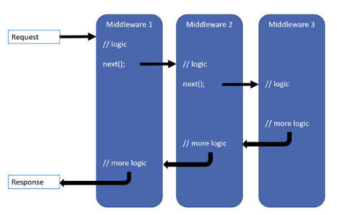
ASP.NET Core Pipeline
The pipeline consists of chained components called “Middlewares”
Each middleware gets a delegate to the next middleware in the chain
The request context gets passed down the chain until handled
The chain then rolls back up to the first middleware

Slide 22
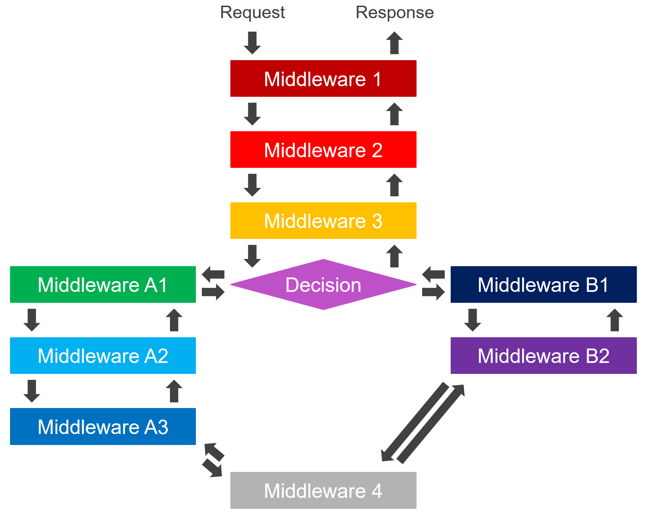
ASP.NET Core Pipeline
Pipelines do not have to be straight all the time, they can
Branch
Merge
Terminate
Example: the “Map” and “MapWhen” middlewares for handling some requests differently
“/admin” requires authentication
“/” does not require authentication

Slide 23
ASP.NET Core Pipeline
Typical usage of middleware:
Add to dependency injection
services.AddMiddleware(configurationDelegate);
services.AddResponseCompression(o =>
o.Providers.Add<GzipCompressionProvider>());
Add to the pipeline in the right order
app.UseMiddleware();
app.UseResponseCompression();
Question: Does this middleware come first or last in the pipeline?

Slide 24
ASP.NET Core Dependency Injection
Dependencies are configured in the ConfigureServices method
Services can be registered:
using interfaces, concrete classes and factory methods
with lifetimes: Transient (default), Scoped (per request, kind of) and Singleton
Services can be resolved:
Constructor injection
Parameter injection (in certain cases!)
Using IServiceProvider injected (not recommended)
No property injection
The default implementation can be easily replaced by Autofac, Ninject, …

Slide 25
Step 6
Building an API

Slide 26
Adding API functionality to the pipeline
Add the required dependency: this will automatically resolve all controllers later on
services.AddControllers();
Add routing to enable resolving actions based on routes
app.UseRouting();
Add endpoints for our actions
app.UseEndpoints(builder => builder.MapControllers());
Remember to add output compression

Slide 27
Anatomy of an API Controller
ApiController attribute
Route attribute
ControllerBase inheritance (Optional)
HttpVerb attributes
public methods that return IActionResult
Result helper methods: Ok, CreatedAt, BadRequest, Conflict, …
using Microsoft.AspNetCore.Mvc;
namespace DevCruise
{
[ApiController]
[Route("/api/room")]
public class RoomController : ControllerBase
{
[HttpGet]
public IActionResult GetRooms()
{
return Ok(new [] {"Fes", "Rabat",
"Nador"} );
}
}
}

Slide 28
Adding the API Controller
Add new folder named “Controllers”
Add new file named “RoomController.cs”
Copy code from previous slide to RoomController file.
Start debugging and browse to /api/room

Slide 29
Step 7
Adding a data store

Slide 30
Describing a data store
Add a persistence provider
Open a terminal window
Type: dotnet add package Microsoft.EntityFrameworkCore.SqLite
In the Model folder add a new file called DevCruiseDbContext.cs
using Microsoft.EntityFrameworkCore;
namespace DevCruise.Model
{
public class DevCruiseDbContext : DbContext
{
public DevCruiseDbContext(DbContextOptions<DevCruiseDbContext> options) : base(options)
{
if (Database.EnsureCreated()) Initialize();
}
}
}

Slide 31
Describing a data store
Add the DevCruiseDbContext to dependency injection
The string is the relative location for the database file.
The DbContext is now ready to hold data and to be injected where we need it
services.AddDbContext<DevCruiseDbContext>(o =>
o.UseSqlite("Data Source=App_Data/DevCruiseDb.sqlite;"));

Slide 32
Creating a model
Refactor the RoomController
Add a new folder called Model
Add a new file called Room.cs
Change the GetAll method to return Enum.GetNames(typeof(Room))
Remember to add using
namespace DevCruise.Model
{
public enum Room
{
Fes = 1,
Rabat = 2,
Nador = 3
}
}

Slide 33
Creating a model
Add 2 more files to the Model folder: Speaker.cs and Session.cs
using System.ComponentModel.DataAnnotations;
namespace DevCruise.Model
{
public class Speaker
{
[Key]
public int Id { get; set; }
[Required, MaxLength(250)]
public string Email { get; set; }
[Required, MaxLength(50)]
public string FirstName { get; set; }
[Required, MaxLength(100)]
public string LastName { get; set; }
[MaxLength(2000)]
public string Bio { get; set; }
}
}
using System.ComponentModel.DataAnnotations;
namespace DevCruise.Model
{
public class Session
{
[Key]
public int Id { get; set; }
[Required, MaxLength(10)]
public string Code { get; set; }
[Required, MaxLength(100)]
public string Title { get; set; }
[Required, MaxLength(2000)]
public string Description { get; set; }
}
}

Slide 34
Adding the entities to the DbContext
Add 2 properties to the DbContext
These properties will be generated into tables by the framework
Add an override to the DbContext
This will add unique indexes on the fields Code and Email, our business keys
public DbSet<Session> Sessions { get; set; }
public DbSet<Speaker> Speakers { get; set; }
protected override void OnModelCreating(ModelBuilder modelBuilder)
{
var session = modelBuilder.Entity<Session>();
session.HasIndex(s => s.Code).IsUnique();
var speaker = modelBuilder.Entity<Speaker>();
speaker.HasIndex(s => s.Email).IsUnique();
}

Slide 35
Initializing the data
Change the constructor of DevCruiseDbContext and make it a partial class
Copy over the DevCruiseDbContext.Initializer.cs file from the Model in the “After” project
public partial class DevCruiseDbContext : DbContext
{
public DevCruiseDbContext(
DbContextOptions<DevCruiseDbContext> options) : base(options)
{
EnsureAppDataDirectory();
if (Database.EnsureCreated()) Initialize();
}
...

Slide 36
Show me the Data!
using DevCruise.Model;
using Microsoft.AspNetCore.Mvc;
using System.Linq;
namespace DevCruise.Controllers
{
[ApiController]
[Route("/api/speaker")]
public class SpeakerController : ControllerBase
{
private DevCruiseDbContext _dbContext;
public SpeakerController(DevCruiseDbContext dbContext)
{
_dbContext = dbContext;
}
[HttpGet]
public IActionResult GetSpeakers()
{
return Ok(_dbContext.Speakers.ToList());
}
}
}
Add a SpeakerController
Debug the result!
Now create the SessionController on your own

Slide 37
Adding methods with parameters
Add a new GET method to the SessionController for a single session
[HttpGet("{code}")]
public IActionResult GetSession(string code)
{
var session = _dbContext.Sessions.SingleOrDefault(
s => s.Code == code);
if(session == null)
return NotFound();
return Ok(session);
}

Slide 38
Step 8
Documenting the API with Swagger

Slide 39
Adding the GET methods for single entities
Add SwashBuckle using Nuget
In the terminal window run
dotnet add package Swashbuckle.AspNetCore --version 5.0.0-rc2
Add the generation of the Swagger document and Swagger UI
These middlewares need to execute BEFORE the Routing middleware
The “v1.0” string in the generation translates to “/v1.0/” in the UI middleware
services.AddSwaggerGen(c => c.SwaggerDoc("v1.0", new OpenApiInfo
{ Title = "DevCruise API Documentation", Version = "1.0" }));
app.UseSwagger();
app.UseSwaggerUI(c => c.SwaggerEndpoint(
"/swagger/v1.0/swagger.json", "DevCruise API v1.0"));

Slide 40
Try out SwaggerUI
Debug the app
Browse to /swagger
Also try /swagger/v1.0/swagger.json
If you want you can change launch.json to always show SwaggerUI for now on
"serverReadyAction": {
"action": "openExternally",
"pattern": "^\\s*Now listening on:\\s+https?://\\S+",
"uriFormat": "http://localhost:5000/swagger"
},

Slide 41
Our work is not finished!
We need to annotate the possible responses our methods can produce, e.g.:
The typeof() function allows us to pass a class type as a Type parameter
StatusCodes is a class in the namespace Microsoft.AspNetCore.Http
If our method can return more than one possible response, we add one attribute per type, e.g. Status200OK and Status404NotFound
All methods should be annotated correctly to produce an accurate Swagger document
Note that all models used are now also shown in the Schemas section of Swagger UI
[ProducesResponseType(typeof(string[]),
StatusCodes.Status200OK)]

Slide 42
Other annotations
A lot of other annotations can be done to enhance the experience of the end-user of the documentation
Tags can be added to sort calls (by controller is the default)
Security requirements, e.g. scopes
Descriptions on parameters
Descriptions on the model
Include existing XML documentation in the Swagger document
…
The necessary attributes live in the Swashbuckle.AspNetCore.Annotations Nuget-package

Slide 43
Step 9
Async all the way!

Slide 44
Async – Await Pattern
Async methods should ALWAYS return a Task or Task<T>
The async keyword tells the runtime to initialize an async state machine
The await keyword tells the runtime to wait for a result and unwrap the Task
More than one Task can be awaited in a single method, also in parallel using Task.WhenAll()
The classes Task and Task<T> live in the System.Threading.Tasks namespace
public async Task<IActionResult> GetSpeakers()
{
var speakers = await _dbContext.Speakers.ToListAsync();
return Ok(speakers);
}

Slide 45
Async – Await Pattern
Common practice is to suffix async methods with “Async”
The actual value returned inside an async method IS NOT a Task
The return value gets wrapped in a Task by the runtime
The await keyword can be used in-line in a statement
Braces can be used to indicate what is actually awaited
Lambda’s and anonymous methods can also be async/await
Interfaces do not use the async keyword, but do use a Task as return value
To implement a function that returns a Task without async and await (e.g. when mocking), use Task.FromResult() or Task.CompletedTask
This is expensive, don’t overuse
https://github.com/davidfowl/AspNetCoreDiagnosticScenarios/blob/master/AsyncGuidance.md

Slide 46
EntityFramework Core and Async
EntityFramework Core provides Async methods for almost all operations
The necessary extension methods live in the Microsoft.EntityFrameworkCore namespace
Examples:
ToListAsync()
ToArrayAsync()
SingleOrDefaultAsync()
ToDictionaryAsync()
CountAsync()
SumAsync()

Slide 47
Exercise
Let’s make this entire API async!

Slide 48
Step 10
Using ViewModels

Slide 49
Introducing ViewModels
Entities are annotated for persistence
More of different validations may be required for the API
Simpler models may be required for lists
Complex structures can be reduced down in the API
We may want to protect some fields from changing e.g. the database ID

Slide 50
Introducing ViewModels
Create a new folder called ViewModels underneath the Controllers folder
Create a class called Session in the ViewModels
Other attributed to try:
EmailAddress, StringLength, Compare,
CreditCard, MinLength, Range, Phone, …
Create another class called SessionDetail
namespace DevCruise.Controllers.ViewModels
{
public class Session
{
public string Code { get; set; }
public string Title { get; set; }
}
}
namespace DevCruise.Controllers.ViewModels
{
public class SessionDetail
{
[Required, MaxLength(10)] public string Code { get; set; }
[Required, MaxLength(100)] public string Title { get; set; }
[Required, MaxLength(2000)] public string Description { get; set; }
}
}

Slide 51
Mapping ViewModels to Models
In the Terminal window run:
dotnet add package Automapper
Add a folder underneath Controllers called MappingProfiles
Add a new class called SessionMapping
using AutoMapper;
namespace DevCruise.Controllers.MappingProfiles
{
public class SessionMapping : Profile
{
public SessionMapping()
{
CreateMap<Model.Session, ViewModels.Session>();
CreateMap<Model.Session, ViewModels.SessionDetail>();
}
}
}

Slide 52
Mapping ViewModels to Models
Add Automapper to dependency injection
Add an IMapper parameter to the controller and a read-only member field to keep it in
Use the Map<T>() function of the IMapper to convert the entities to viewmodels
Remember to also change the ProducesResponseType attributes to the viewmodels!
Try it out!
services.AddSingleton<IConfigurationProvider>(s =>
new MapperConfiguration(c => c.AddMaps(typeof(Startup))));
services.AddScoped(s => s.GetService<IConfigurationProvider>().CreateMapper(s.GetService));
return Ok(_mapper.Map<ViewModels.SessionDetail[]>(sessions));
return Ok(_mapper.Map<ViewModels.SessionDetail>(session));

Slide 53
Can we improve on the mapping?
We are mapping the results of the database query, so we are querying fields we don’t use
We can prevent this by using the ProjectTo<T>() extension method
SELECT "s"."Id", "s"."Code", "s"."Description", "s"."Title"
FROM "Sessions" AS "s"
var sessions = await _dbContext.Sessions
.ProjectTo<ViewModels.Session>(_mapper.ConfigurationProvider)
.ToListAsync();
return Ok(sessions);
SELECT "dtoSession"."Code", "dtoSession"."Title" FROM "Sessions" AS "dtoSession"

Slide 54
Step 11
Completing the CRUD methods

Slide 55
DbContext as a Unit-of-Work
The DbContext tracks changes to entities for as long as it exists
All entities queried through the DbContext will be tracked automatically
Entities created outside of the DbContext can be added to it for tracking
The DbContext can persist all changes in a single transaction using SaveChangesAsync()
The default behavior of the dependency injection system will give you a single DbContext instance per request
The DbContext will thus automatically function as a Unit-of-Work, ideal for simple use cases

Slide 56
Adding a POST method
In the SessionController add the following
[HttpPost]
[ProducesResponseType(typeof(ViewModels.SessionDetail[]), StatusCodes.Status201Created)]
[ProducesResponseType(StatusCodes.Status400BadRequest)]
[ProducesResponseType(StatusCodes.Status409Conflict)]
public async Task<IActionResult> CreateSession([FromBody] ViewModels.SessionDetail newSession)
{
var duplicateCodeExists = await _dbContext.Sessions.AnyAsync(s => s.Code == newSession.Code);
if (duplicateCodeExists)
return this.Problem(StatusCodes.Status409Conflict, nameof(newSession.Code),
$"Session with code {newSession.Code} already exists");
var session = _mapper.Map<Session>(newSession);
await _dbContext.AddAsync(session);
await _dbContext.SaveChangesAsync();
return CreatedAtAction(nameof(GetSession), new { code = session.Code },
_mapper.Map<ViewModels.SessionDetail>(session));
}

Slide 57
Oops! What is this.Problem()?
We will add a small extension method to make returning problems easier
The source code can be found in the “After” folder under Controllers/Extensions/ProblemDetailsExtensions.cs
To use it we add a using statement for the DevCruise.Controllers.Extensions namespace
This extension method will format our problems to conform to IETF RFC 7807
https://tools.ietf.org/html/rfc7807

Slide 58
Adding a PUT method
In the SessionController add the following
[HttpPut("{code}")]
[ProducesResponseType(typeof(ViewModels.SessionDetail), StatusCodes.Status200OK)]
[ProducesResponseType(StatusCodes.Status400BadRequest)]
[ProducesResponseType(StatusCodes.Status404NotFound)]
public async Task<IActionResult> UpdateSession(string code,
[FromBody] ViewModels.SessionDetail updatedSession)
{
var session = await _dbContext.Sessions.SingleOrDefaultAsync(s => s.Code == code);
if (session == null)
return this.Problem(StatusCodes.Status404NotFound, nameof(code),
$"Session with code {code} not found");
_mapper.Map(updatedSession, session);
await _dbContext.SaveChangesAsync();
return Ok(_mapper.Map<ViewModels.SessionDetail>(session));
}

Slide 59
Wait a minute, we still need to prevent duplicate codes!
The unique index on the database will take care of that, but to present a nicer error to the caller we can add the following before the first _mapper.Map()
Remember we now also have to indicate that a 409 response is possible
if (!string.Equals(updatedSession.Code, code))
{
var duplicateCodeExists = await _dbContext.Sessions.AnyAsync(s =>
s.Code == updatedSession.Code);
if (duplicateCodeExists)
return this.Problem(StatusCodes.Status409Conflict, nameof(code),
$"Session with code {code} already exists");
}
[ProducesResponseType(StatusCodes.Status409Conflict)]

Slide 60
Finally add the DELETE method
In the SessionController add the following
[HttpDelete("{code}")]
[ProducesResponseType(typeof(ViewModels.SessionDetail), StatusCodes.Status200OK)]
[ProducesResponseType(StatusCodes.Status404NotFound)]
[ProducesResponseType(StatusCodes.Status409Conflict)]
public async Task<IActionResult> DeleteSession(string code)
{
var session = await _dbContext.Sessions.SingleOrDefaultAsync(s => s.Code == code);
if (session == null)
return this.Problem(StatusCodes.Status404NotFound, nameof(code),
$"Session with code {code} not found");
_dbContext.Sessions.Remove(session);
await _dbContext.SaveChangesAsync();
return Ok(_mapper.Map<ViewModels.SessionDetail>(session));
}

Slide 61
Is that it?
Not quite, if we run now and POST a new session we will get: AutoMapper.AutoMapperMappingException: Missing type map configuration or unsupported mapping
We still have to add the reverse mapping to our mapping profile
But basically that’s it!
Now try doing the same for the Speaker entity yourself
CreateMap<ViewModels.SessionDetail, Model.Session>();

Slide 62
Step 12
Authentication and Authorization

Slide 63
Adding JWT Bearer Token Authentication
Add the Microsoft.AspNetCore.Authentication.JwtBearer Nuget package
Add the authentication to dependency injection (Azure AD in this case)
Add the authentication middleware to the pipeline
The order is very important here: add after Routing and before Endpoints
services.AddAuthentication(JwtBearerDefaults.AuthenticationScheme).AddJwtBearer(o =>
{
o.Authority =
"https://login.microsoftonline.com/0b53d2c1-bc55-4ab3-a161-927d289257f2/v2.0";
o.Audience = "4be39034-c55a-4ab3-bd3a-38fa0664bb53";
});
app.UseAuthentication();

Slide 64
But wait, everything still works and I didn’t authenticate!
True, we have stated that we would accept authentication by AAD if offered, but we have not set up security barriers to our API yet.
For this we use the second part: Authorization
With Authorization we will declare policies that will block unauthorized users

Slide 65
Add Authorization policies
First we add a new folder called Security and a class called Scopes
namespace DevCruise.Security
{
public static class Scopes
{
public const string ReadAccess = "readAccess";
public const string WriteAccess = "writeAccess";
public const string AadScopePrefix = "api://devCruiseApi/";
public const string AadReadAccess = AadScopePrefix + ReadAccess;
public const string AadWriteAccess = AadScopePrefix + WriteAccess;
public const string ScopeClaimType = "http://schemas.microsoft.com/identity/claims/scope";
public static bool HasScope(this ClaimsPrincipal user, string scopeName)
=> user.FindFirst(Scopes.ScopeClaimType)?.Value.Split(' ')
.Contains(scopeName) ?? false;
}
}

Slide 66
Add Authorization policies
Add the policies to dependency injection
Add the authorization middleware
Now we apply the policy where we want using the Authorize attribute
The attribute can be applied to the controller and overridden on any method
services.AddAuthorization(o =>
{
o.AddPolicy(Scopes.ReadAccess, builder => builder.RequireAssertion(context =>
context.User.HasScope(Scopes.ReadAccess)));
o.AddPolicy(Scopes.WriteAccess, builder => builder.RequireAssertion(context =>
context.User.HasScope(Scopes.WriteAccess)));
});
app.UseAuthorization();
[Authorize(Scopes.ReadAccess)]

Slide 67
Authentication now works!
Great, any method we try now returns a 401!
… but now our Swagger UI is useless ☹
We still have to
tell Swagger about our authentication requirements
and tell Swagger UI where to get it’s tokens
… easy ☺

Slide 68
Adding scope requirements to Swagger
For this we use an IOperationFilter
Copy over the SecurityRequirementsOperationFilter class from the “After” folder
We then add the new filter to the SwaggerGen registration from earlier
services.AddSwaggerGen(c =>
{
c.SwaggerDoc("v1.0", new OpenApiInfo { Title =
"DevCruise API Documentation", Version = "1.0" });
c.OperationFilter<SecurityRequirementsOperationFilter>();
});

Slide 69
Adding scope requirements to Swagger
Last we add the full declaration of our security to the Swagger document so clients know what the need to do to authenticate
c.AddSecurityDefinition("oauth2", new OpenApiSecurityScheme
{
Type = SecuritySchemeType.OAuth2,
Flows = new OpenApiOAuthFlows
{
Implicit = new OpenApiOAuthFlow
{
AuthorizationUrl = new Uri(
"https://login.microsoftonline.com/0b53d2c1-bc55-4ab3-a161-927d289257f2/oauth2/v2.0/authorize"),
Scopes = new Dictionary<string, string>
{
{ Scopes.AadReadAccess, "Access read operations" },
{ Scopes.AadWriteAccess, "Access write operations" }
}
}
}
});

Slide 70
Just one last piece missing
The Swagger document is now complete
There is a securitySchemes element at the bottom
Every method has a security element
Every method declares 401 and 403 results
Now Swagger UI needs to know it’s ClientID for Azure AD to authenticate
app.UseSwaggerUI(c =>
{
c.SwaggerEndpoint("/swagger/v1.0/swagger.json", "DevCruise API v1.0");
c.OAuthClientId("4be39034-c55a-4ab3-bd3a-38fa0664bb53");
});

Slide 71
Want to know what all of this stuff means?
See you this afternoon at 18:55!

Slide 72


Slide 73
Resources
Docs
https://docs.microsoft.com/en-us/aspnet/core/getting-started/?view=aspnetcore-3.0
https://docs.microsoft.com/en-us/aspnet/core/fundamentals/?view=aspnetcore-3.0
https://docs.microsoft.com/en-us/aspnet/core/web-api/?view=aspnetcore-3.0
https://docs.microsoft.com/en-us/ef/core/
Learn
https://docs.microsoft.com/en-us/learn/modules/build-web-api-net-core/?view=aspnetcore-3.0

Slide 74
Now have fun exploring ASP.NET Core for yourself!

